Slide 1
Project Name
By: Team/Group Name

Slide 2
Team Details
Name | PS Number

Slide 3
Description
Dash Flight Booking Portal serves the functionality of booking flight across various destination.
The front-end interface is designed using Angular 8, HTML 5, CSS, Bootstrap and Angular Material.
The back-end interface is designed using ASP.NET Web API, SQL Server Management Studio.
The website allows registration for new users and existing users can login into their account.
The website also allows admin login for admin who can add new flight and can also delete any existing flight.
The admin can also view the details of the users and flight details.
The project has been implemented using DB First approach.
The project take care of different modules like user module, admin module, flight search module and many more which are discussed later.
The application designed is user friendly and it becomes really easier for user to book their flights to travel to their destinations.

Slide 4
Objectives
A portal to search and book flights.
Enables user to select seat of their choice from the available seats.
Users can also select the class to travel in from the available two classes which are Economy class and Business class.
After successful booking and payment the users can also print the ticket which contains the details of their booking.
The service allows everyone to travel from source to their destination safely.

Slide 5
Scope
The Online Airline Reservation system has the following scope:
Airline Reservation System is one of the modifications that were carried out in the passenger Service so that the working and availability of Service can be broadened.
The system allows to carry out reservation on the desired airline from any place in India.
The system saves time as it allows online procedure as users no longer need to wait in long queue to book flights.
Admin is the main authority who can add, delete flights and can also view the user details.
With the help of this system, customers can view all the different flight’s availability with different timing for a particular date and it also allow them to reserve a seat and cancel a reservation.
Apart from the flight details, the user can login and view his/her booking history.
The user can print the ticket which contains the booking information.

Slide 6
Modules
Registration – User
Login – Login as User
Login as Admin
Admin Module
Login
Add and Delete flights
User module
Login
Register
Flight Search
Flight Search
Flight Select
Payment Module
Cancellation Module
Flight Search Module
Flight Select Module

Slide 7
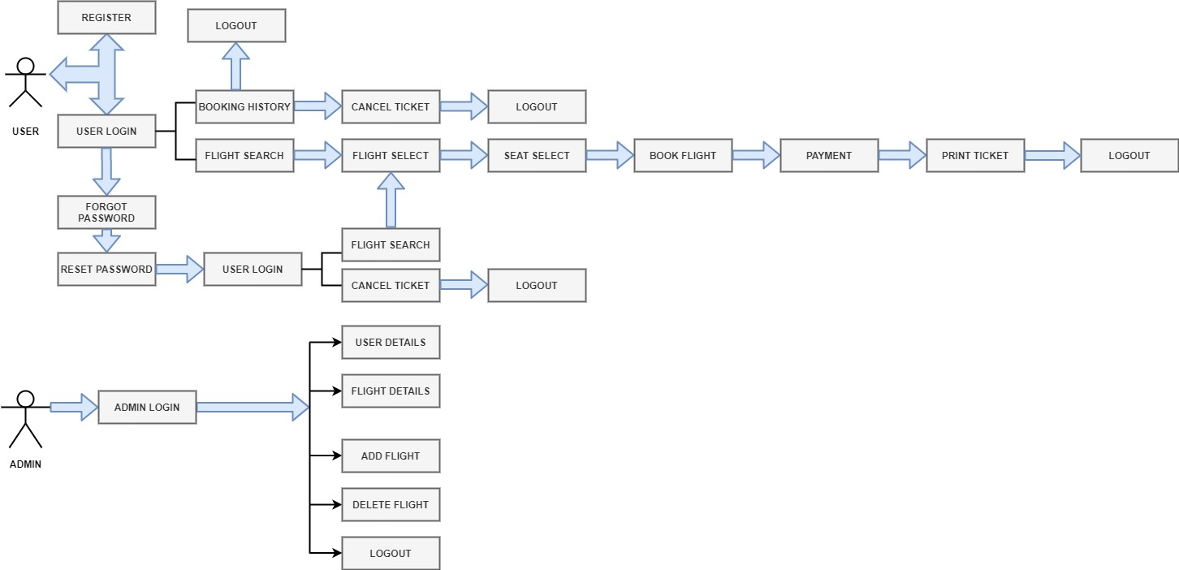
Application Flow

